Slide 1
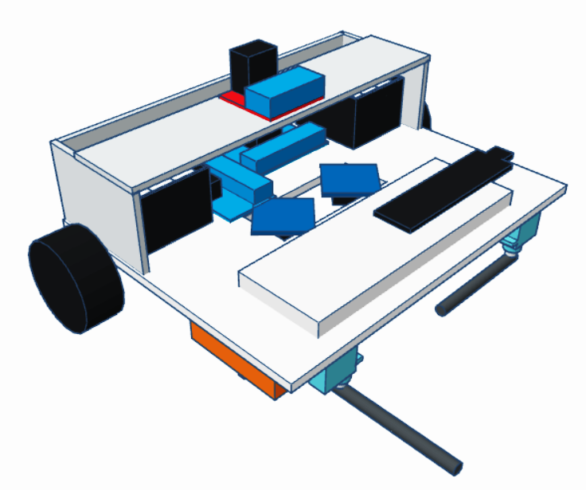
Project Presentation
Team ID : Group 15
System Integrator : Chia Kok Bond (30893062)
Programmer : Mah Yuen Yee (30213673)
Notes:
System block 2.5min
Crucial aspects 1.1min
Movement 3.3min
Colour 1.7min
Puck 2.1min
Alternative 1min

Slide 2
K
I
S
S
Keep It Short And Simple
Keep It Fast And Simple

Slide 3
Presentation Structure
01 System Overview (CKB)
System Block Diagram
Crucial Aspects of Design
02 Design Methodology
Motion Flow & Key Methods
Movement mechanism (MYY)
Colour Sensing mechanism (MYY)
Puck Handling mechanism (CKB)
03 Decision Making (MYY)
Unused Alternative Design
04 Conclusion (CKB)

Slide 4
01 System Overview
System Block Diagram
Crucial Aspects of Design
System Overview
Design Methodology
System Block Diagram
Crucial Aspects of Design
Motion Flow & Key Methods
Movement Mechanism
Puck Handling Mechanism
Colour Sensing Mechanism
Decision Making
Unused Alternative

Slide 5
System Block Diagram
System Overview
Design Methodology
Crucial Aspects of Design
Motion Flow & Key Methods
Movement Mechanism
Puck Handling Mechanism
Colour Sensing Mechanism
Decision Making
Unused Alternative

Slide 6
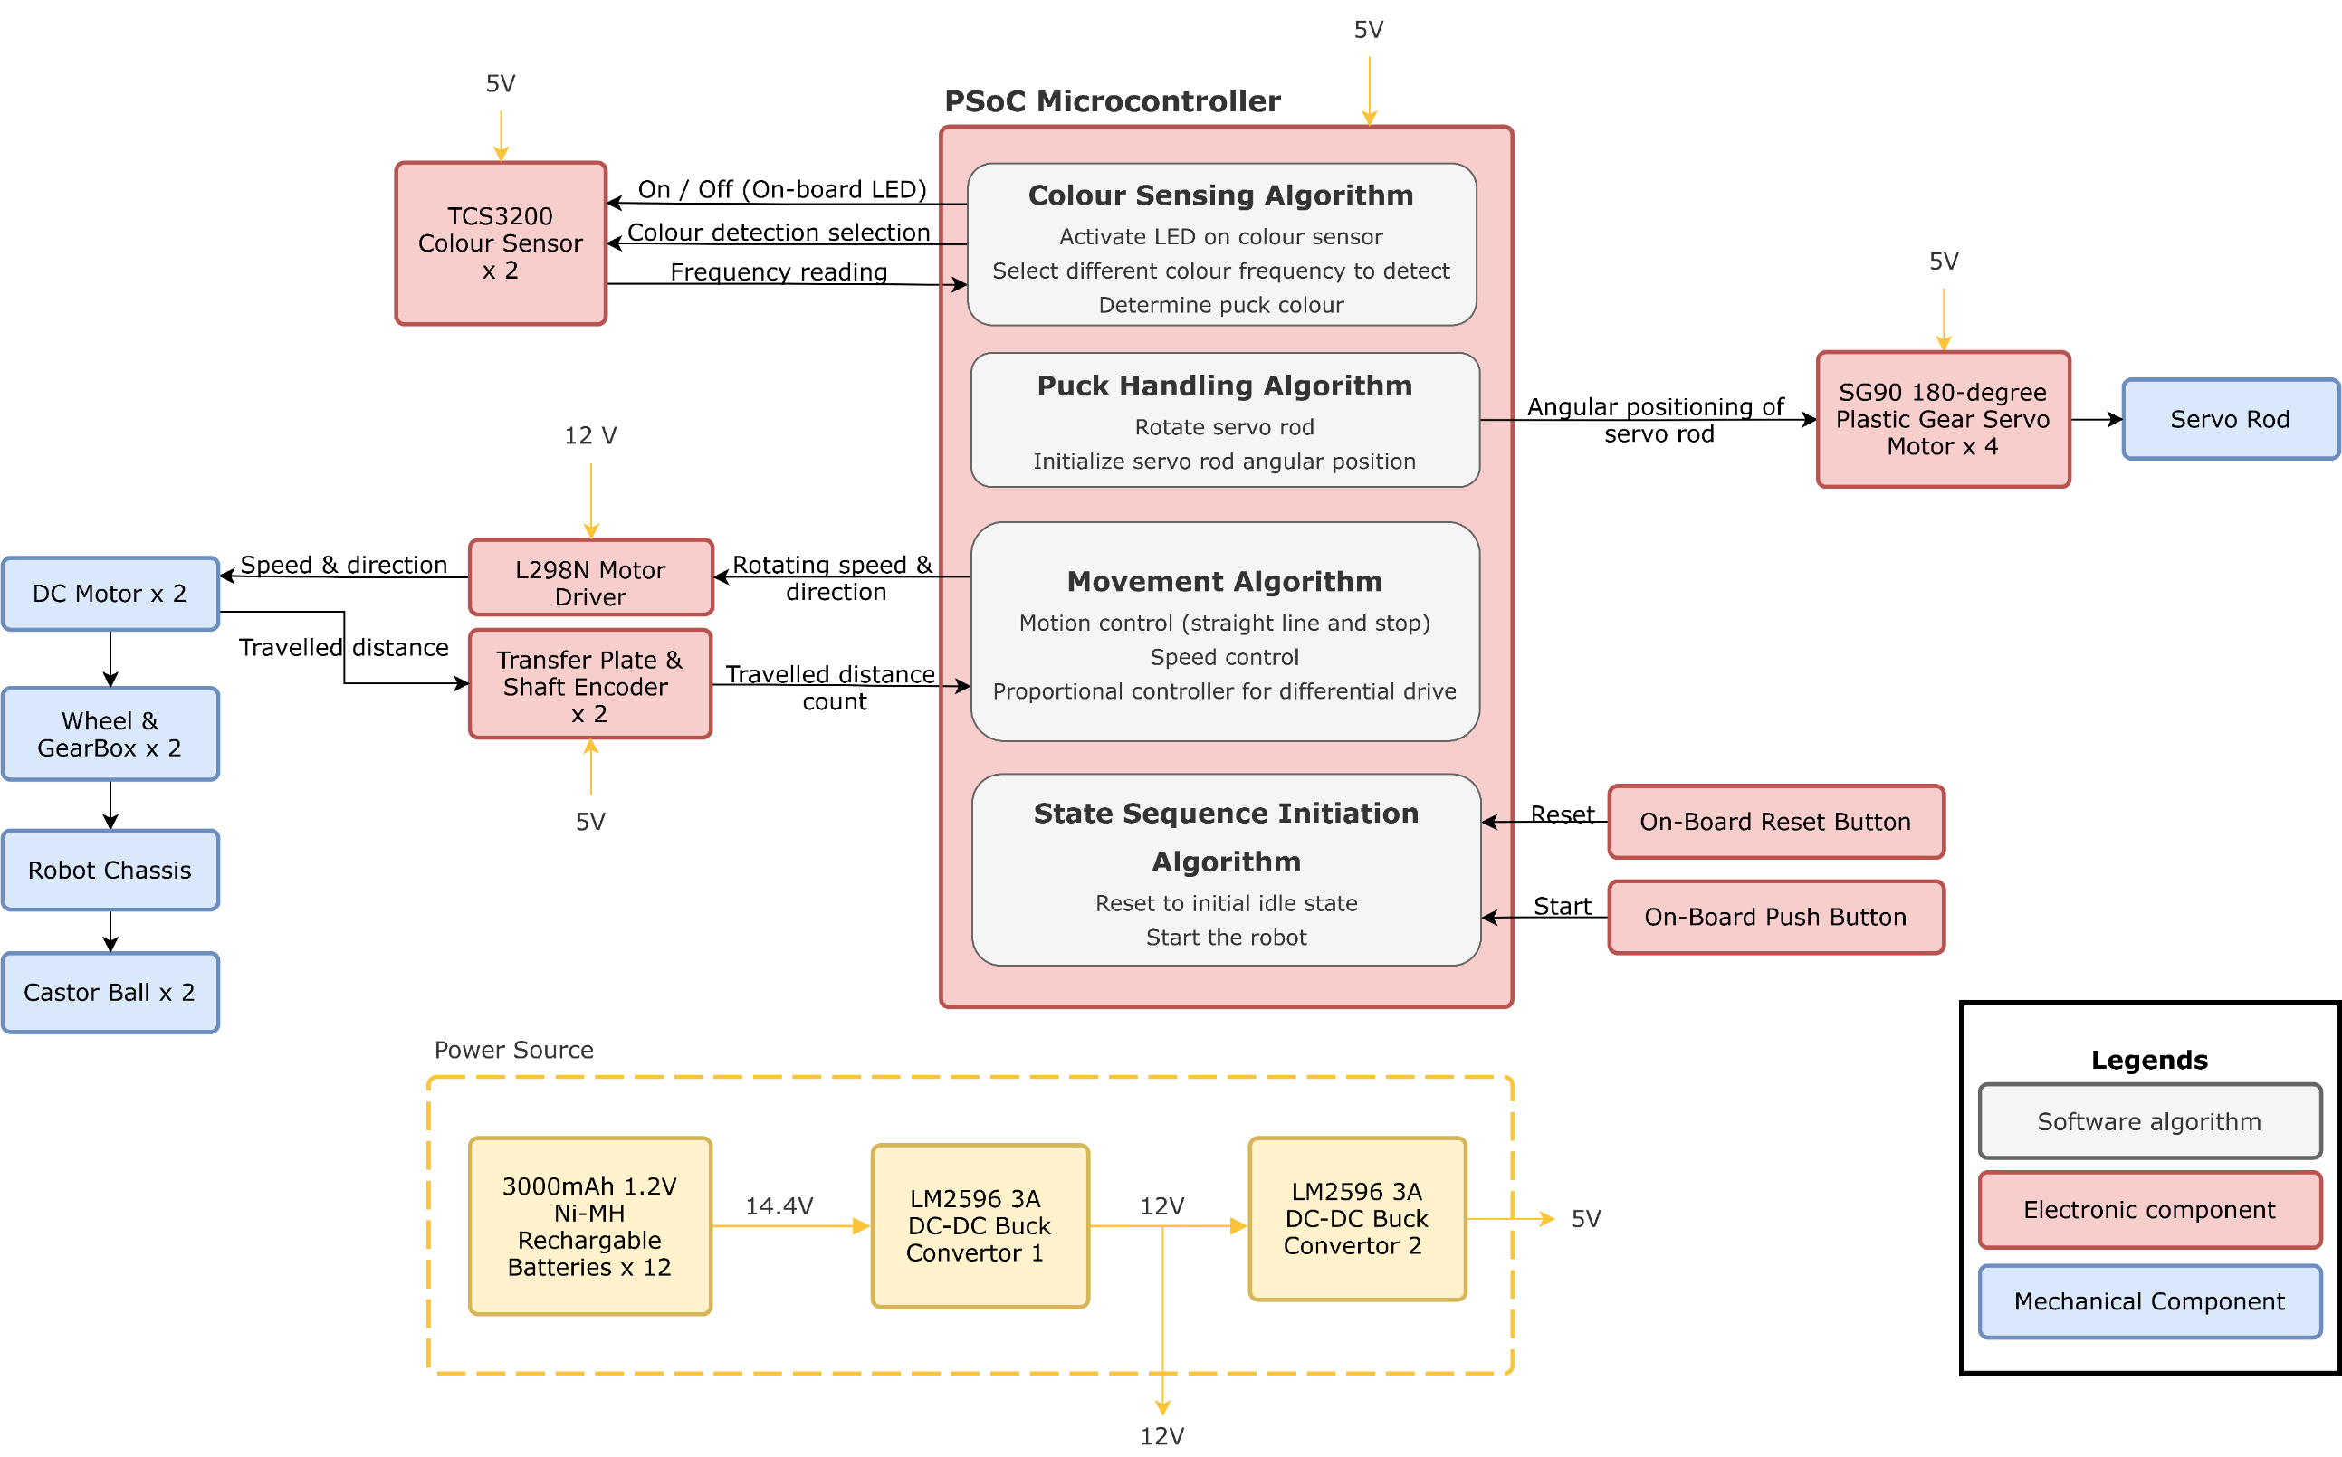
Fig. 1 System block diagram.
Colour Sensing Subsystem
Puck Handling Subsystem
Movement Subsystem
State Sequence Initiation Subsystem
System Block Diagram
Fig. 1 System block diagram.
System Overview
Design Methodology
Crucial Aspects of Design
Motion Flow & Key Methods
Movement Mechanism
Puck Handling Mechanism
Colour Sensing Mechanism
Decision Making
Unused Alternative
Notes:
To handle all aspects of tasks provided in this project, there are 4 main subsystems implemented in the robot which are colour sensing, puck handling, movement, and state sequence initiation subsystems.
First is about the colour sensing subsystem. Its algorithm outputs 2 types of signals to the 2 TCS3200 colour sensors, one to switch on and off the attached LEDs, the other is for activation of photodiodes with filter of different colours. The algorithm receives input signal of square wave with different frequency to determine puck colour.
Secondly, it’s about the puck handling subsystem. The algorithm outputs analogue signal of pulse width modulator compare value which represents the duty cycle for angular positioning of servo rod to any of the 4 SG90 plastic gear servo motors. The servo motor would then rotate its rod accordingly to flick puck.
Next is the movement subsystem. The algorithm sends signals to the motor driver to inform the intended rotating speed and direction of the wheels to move and stop the robot. The motor driver then outputs the information to the DC motors by changing voltage supplied. Each DC motor has its shaft attached to a gearbox which is connected to a wheel so that the DC motor shaft and the wheel has the same speed and direction. The shaft encoder attached to each DC motor can indirectly capture the angular displacement of the wheel. The signals are then fed back into the algorithm consistently to enable motion control, speed control and differential drive control.
The fourth is the state sequence initialization subsystem. A press of the reset button on the PSoC board signals the algorithm to reset the robot to be in the initial idle state. The on-board push button can then be pressed to inform the algorithm to traverse from the initial idle state to state 2 to kickstart the robot activities.
Lastly, 12 3000mAh Ni-MH rechargeable batteries are used to supply 14.4V which is stepped down to 12V by a DC-DC buck convertor (Full name)to power DC motors via motor driver. The 12V is then stepped down again to 5V to power the remaining electronics.
~2.3m

Slide 7
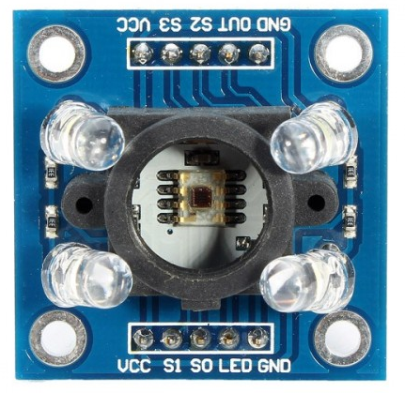
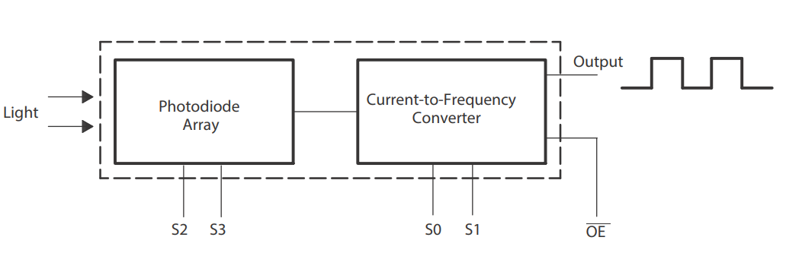
Fig. 1 System block diagram.
Colour Sensing Subsystem
Colour Sensing Subsystem
Photodiodes
LEDs
Fig. 2 TCS3200 colour sensor [1].
Fig. 3 TCS3200 colour sensor block diagram [2].
System Block Diagram
Fig. 1 System block diagram.
System Overview
Design Methodology
Crucial Aspects of Design
Motion Flow & Key Methods
Movement Mechanism
Puck Handling Mechanism
Colour Sensing Mechanism
Decision Making
Unused Alternative
Notes:
To handle all aspects of tasks provided in this project, there are 4 main subsystems implemented in the robot which are colour sensing, puck handling, movement, and state sequence initiation subsystems.
First is about the colour sensing subsystem. Its algorithm outputs 2 types of signals to the 2 TCS3200 colour sensors, one to switch on and off the attached LEDs, the other is for activation of photodiodes with filter of different colours. The algorithm receives input signal of square wave with different frequency to determine puck colour.
Secondly, it’s about the puck handling subsystem. The algorithm outputs analogue signal of pulse width modulator compare value which represents the duty cycle for angular positioning of servo rod to any of the 4 SG90 plastic gear servo motors. The servo motor would then rotate its rod accordingly to flick puck.
Next is the movement subsystem. The algorithm sends signals to the motor driver to inform the intended rotating speed and direction of the wheels to move and stop the robot. The motor driver then outputs the information to the DC motors by changing voltage supplied. Each DC motor has its shaft attached to a gearbox which is connected to a wheel so that the DC motor shaft and the wheel has the same speed and direction. The shaft encoder attached to each DC motor can indirectly capture the angular displacement of the wheel. The signals are then fed back into the algorithm consistently to enable motion control, speed control and differential drive control.
The fourth is the state sequence initialization subsystem. A press of the reset button on the PSoC board signals the algorithm to reset the robot to be in the initial idle state. The on-board push button can then be pressed to inform the algorithm to traverse from the initial idle state to state 2 to kickstart the robot activities.
Lastly, 12 3000mAh Ni-MH rechargeable batteries are used to supply 14.4V which is stepped down to 12V by a DC-DC buck convertor (Full name)to power DC motors via motor driver. The 12V is then stepped down again to 5V to power the remaining electronics.
~2.3m

Slide 8
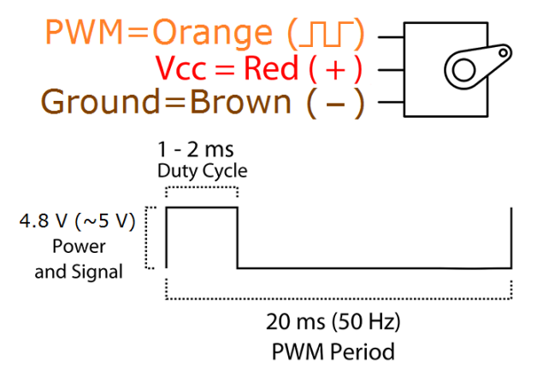
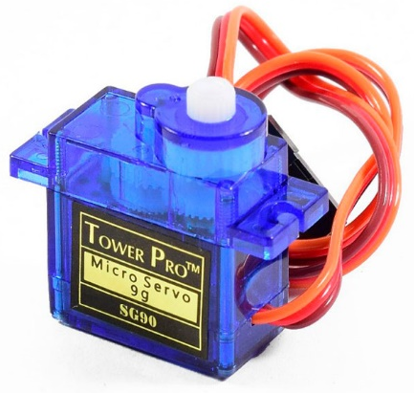
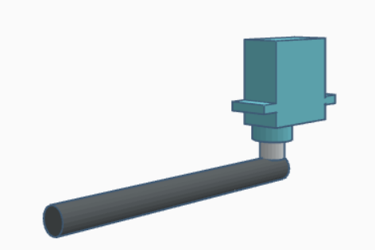
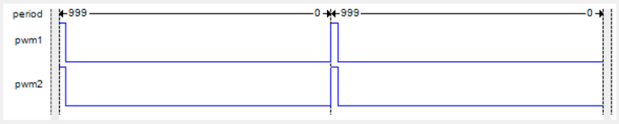
System Block Diagram
Fig. 1 System block diagram.
Puck Handling Subsystem
Colour Sensing Subsystem
Puck Handling Subsystem
Movement Subsystem
Fig. 4 Input and output pins of SG90 plastic gear servo motor [3].
State Sequence Initiation Subsystem
Fig. 6 180-degree SG90 plastic gear servo motor [4].
Fig. 7 Servo motor with a rod attached.
Fig. 5 PWM compare value controls duty cycle.
System Block Diagram
Fig. 1 System block diagram.
System Overview
Design Methodology
Crucial Aspects of Design
Motion Flow & Key Methods
Movement Mechanism
Puck Handling Mechanism
Colour Sensing Mechanism
Decision Making
Unused Alternative
Notes:
To handle all aspects of tasks provided in this project, there are 4 main subsystems implemented in the robot which are colour sensing, puck handling, movement, and state sequence initiation subsystems.
First is about the colour sensing subsystem. Its algorithm outputs 2 types of signals to the 2 TCS3200 colour sensors, one to switch on and off the attached LEDs, the other is for activation of photodiodes with filter of different colours. The algorithm receives input signal of square wave with different frequency to determine puck colour.
Secondly, it’s about the puck handling subsystem. The algorithm outputs analogue signal of pulse width modulator compare value which represents the duty cycle for angular positioning of servo rod to any of the 4 SG90 plastic gear servo motors. The servo motor would then rotate its rod accordingly to flick puck.
Next is the movement subsystem. The algorithm sends signals to the motor driver to inform the intended rotating speed and direction of the wheels to move and stop the robot. The motor driver then outputs the information to the DC motors by changing voltage supplied. Each DC motor has its shaft attached to a gearbox which is connected to a wheel so that the DC motor shaft and the wheel has the same speed and direction. The shaft encoder attached to each DC motor can indirectly capture the angular displacement of the wheel. The signals are then fed back into the algorithm consistently to enable motion control, speed control and differential drive control.
The fourth is the state sequence initialization subsystem. A press of the reset button on the PSoC board signals the algorithm to reset the robot to be in the initial idle state. The on-board push button can then be pressed to inform the algorithm to traverse from the initial idle state to state 2 to kickstart the robot activities.
Lastly, 12 3000mAh Ni-MH rechargeable batteries are used to supply 14.4V which is stepped down to 12V by a DC-DC buck convertor (Full name)to power DC motors via motor driver. The 12V is then stepped down again to 5V to power the remaining electronics.
~2.3m

Slide 9
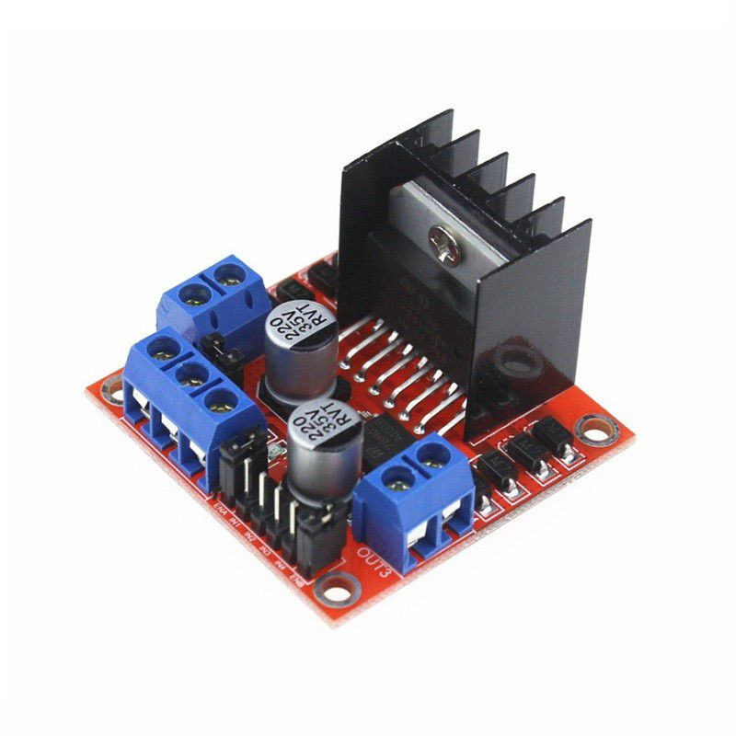
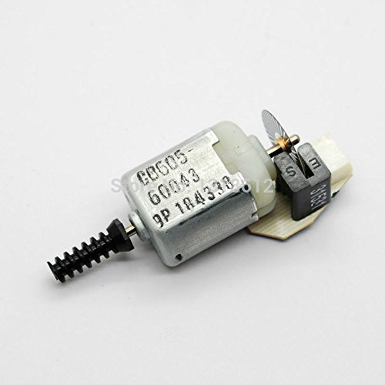
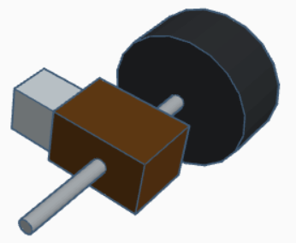
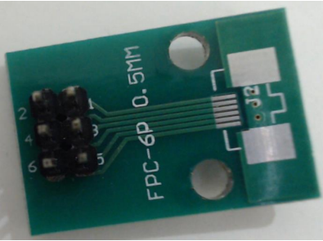
System Block Diagram
Fig. 1 System block diagram.
Fig. 9 L298N motor driver [6].
Movement Subsystem
Fig. 8 DC motor with shaft encoder [5].
Colour Sensing Subsystem
Movement Subsystem
DC motor with attached shaft encoder
Wheel
Puck Handling Subsystem
Gearbox
Spinning rod
State Sequence Initiation Subsystem
Fig. 11 Wheel set.
Fig. 10 Transfer plate [7].
System Block Diagram
Fig. 1 System block diagram.
System Overview
Design Methodology
Crucial Aspects of Design
Motion Flow & Key Methods
Movement Mechanism
Puck Handling Mechanism
Colour Sensing Mechanism
Decision Making
Unused Alternative
Notes:
To handle all aspects of tasks provided in this project, there are 4 main subsystems implemented in the robot which are colour sensing, puck handling, movement, and state sequence initiation subsystems.
First is about the colour sensing subsystem. Its algorithm outputs 2 types of signals to the 2 TCS3200 colour sensors, one to switch on and off the attached LEDs, the other is for activation of photodiodes with filter of different colours. The algorithm receives input signal of square wave with different frequency to determine puck colour.
Secondly, it’s about the puck handling subsystem. The algorithm outputs analogue signal of pulse width modulator compare value which represents the duty cycle for angular positioning of servo rod to any of the 4 SG90 plastic gear servo motors. The servo motor would then rotate its rod accordingly to flick puck.
Next is the movement subsystem. The algorithm sends signals to the motor driver to inform the intended rotating speed and direction of the wheels to move and stop the robot. The motor driver then outputs the information to the DC motors by changing voltage supplied. Each DC motor has its shaft attached to a gearbox which is connected to a wheel so that the DC motor shaft and the wheel has the same speed and direction. The shaft encoder attached to each DC motor can indirectly capture the angular displacement of the wheel. The signals are then fed back into the algorithm consistently to enable motion control, speed control and differential drive control.
The fourth is the state sequence initialization subsystem. A press of the reset button on the PSoC board signals the algorithm to reset the robot to be in the initial idle state. The on-board push button can then be pressed to inform the algorithm to traverse from the initial idle state to state 2 to kickstart the robot activities.
Lastly, 12 3000mAh Ni-MH rechargeable batteries are used to supply 14.4V which is stepped down to 12V by a DC-DC buck convertor (Full name)to power DC motors via motor driver. The 12V is then stepped down again to 5V to power the remaining electronics.
~2.3m

Slide 10

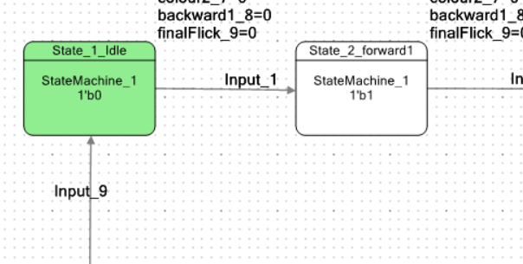
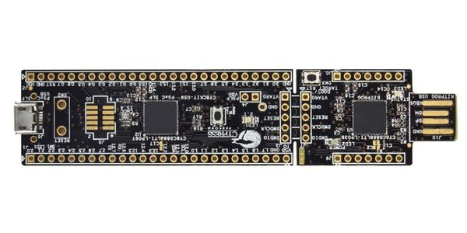
System Block Diagram
State Sequence Initiation Subsystem
Fig. 1 System block diagram.
Colour Sensing Subsystem
Reset button
Push button
Puck Handling Subsystem
Movement Subsystem
Fig. 12 Initial idle state and state 2 of state machine.
Fig. 13 PSoC 5LP prototyping kit (CY8CKIT-059) [8].
State Sequence Initiation Subsystem
System Block Diagram
Fig. 1 System block diagram.
System Overview
Design Methodology
Crucial Aspects of Design
Motion Flow & Key Methods
Movement Mechanism
Puck Handling Mechanism
Colour Sensing Mechanism
Decision Making
Unused Alternative
Notes:
To handle all aspects of tasks provided in this project, there are 4 main subsystems implemented in the robot which are colour sensing, puck handling, movement, and state sequence initiation subsystems.
First is about the colour sensing subsystem. Its algorithm outputs 2 types of signals to the 2 TCS3200 colour sensors, one to switch on and off the attached LEDs, the other is for activation of photodiodes with filter of different colours. The algorithm receives input signal of square wave with different frequency to determine puck colour.
Secondly, it’s about the puck handling subsystem. The algorithm outputs analogue signal of pulse width modulator compare value which represents the duty cycle for angular positioning of servo rod to any of the 4 SG90 plastic gear servo motors. The servo motor would then rotate its rod accordingly to flick puck.
Next is the movement subsystem. The algorithm sends signals to the motor driver to inform the intended rotating speed and direction of the wheels to move and stop the robot. The motor driver then outputs the information to the DC motors by changing voltage supplied. Each DC motor has its shaft attached to a gearbox which is connected to a wheel so that the DC motor shaft and the wheel has the same speed and direction. The shaft encoder attached to each DC motor can indirectly capture the angular displacement of the wheel. The signals are then fed back into the algorithm consistently to enable motion control, speed control and differential drive control.
The fourth is the state sequence initialization subsystem. A press of the reset button on the PSoC board signals the algorithm to reset the robot to be in the initial idle state. The push button can then be pressed to inform the algorithm to traverse from the initial idle state to state 2 to kickstart the robot activities.
Lastly, 12 3000mAh Ni-MH rechargeable batteries are used to supply 14.4V which is stepped down to 12V by a DC-DC buck convertor (Full name)to power DC motors via motor driver. The 12V is then stepped down again to 5V to power the remaining electronics.
~2.3m

Slide 11
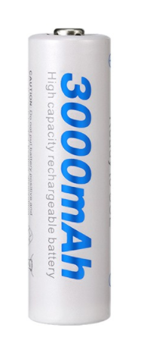
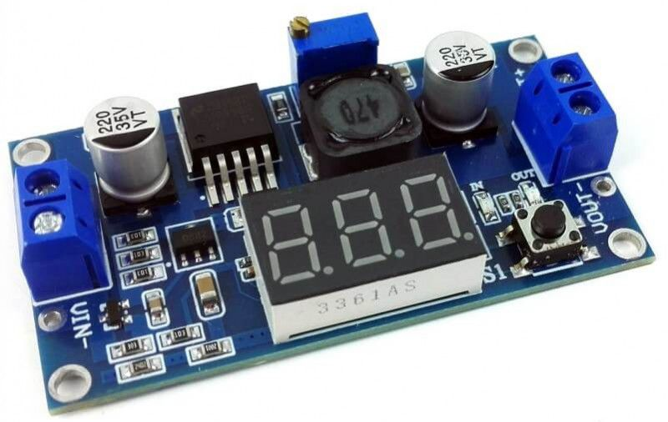
Power Supply
Fig. 1 System block diagram.
Colour Sensing Subsystem
Puck Handling Subsystem
Movement Subsystem
Fig. 14 A 3000mAh Ni-MH rechargeable battery [9].
Fig. 15 LM2596 3A DC-DC adjustable step down voltage regular / buck convertor with display [10].
State Sequence Initiation Subsystem
System Block Diagram
Fig. 1 System block diagram.
System Overview
Design Methodology
Crucial Aspects of Design
Motion Flow & Key Methods
Movement Mechanism
Puck Handling Mechanism
Colour Sensing Mechanism
Decision Making
Unused Alternative
Notes:
To handle all aspects of tasks provided in this project, there are 4 main subsystems implemented in the robot which are colour sensing, puck handling, movement, and state sequence initiation subsystems.
First is about the colour sensing subsystem. Its algorithm outputs 2 types of signals to the 2 TCS3200 colour sensors, one to switch on and off the attached LEDs, the other is for activation of photodiodes with filter of different colours. The algorithm receives input signal of square wave with different frequency to determine puck colour.
Secondly, it’s about the puck handling subsystem. The algorithm outputs analogue signal of pulse width modulator compare value which represents the duty cycle for angular positioning of servo rod to any of the 4 SG90 plastic gear servo motors. The servo motor would then rotate its rod accordingly to flick puck.
Next is the movement subsystem. The algorithm sends signals to the motor driver to inform the intended rotating speed and direction of the wheels to move and stop the robot. The motor driver then outputs the information to the DC motors by changing voltage supplied. Each DC motor has its shaft attached to a gearbox which is connected to a wheel so that the DC motor shaft and the wheel has the same speed and direction. The shaft encoder attached to each DC motor can indirectly capture the angular displacement of the wheel. The signals are then fed back into the algorithm consistently to enable motion control, speed control and differential drive control.
The fourth is the state sequence initialization subsystem. A press of the reset button on the PSoC board signals the algorithm to reset the robot to be in the initial idle state. The on-board push button can then be pressed to inform the algorithm to traverse from the initial idle state to state 2 to kickstart the robot activities.
Lastly, 12 3000mAh Ni-MH rechargeable batteries are used to supply 14.4V which is stepped down to 12V by a DC-DC buck convertor to power DC motors via motor driver. The 12V is then stepped down again to 5V to power the remaining electronics.
~2.3m

Slide 12
Crucial Aspects of Design
System Overview
Design Methodology
System Block Diagram
Motion Flow & Key Methods
Movement Mechanism
Puck Handling Mechanism
Colour Sensing Mechanism
Decision Making
Unused Alternative

Slide 13
Crucial Aspects of Design
Shortest route movement strategy
Shortest movement time to visit all the zones
Move forwards and backwards only
No point turning
4 servo motor puck flicking mechanism
Each servo motor is responsible to each puck
Start accumulating points right after zones visiting with no additional robot movement
Crucial Aspects of Design
System Overview
Design Methodology
System Block Diagram
Crucial Aspects of Design
Motion Flow & Key Methods
Movement Mechanism
Puck Handling Mechanism
Colour Sensing Mechanism
Decision Making
Unused Alternative
Notes:
There is something interesting that the system block diagram cannot show, the crucial aspects of the design.
This competition requires a fast and reliable robot to shift as many pucks as possible in a limited period. Therefore, to ensure shortest movement time and shortest travelled distance to visit all the collection zones, the robot moves forwards straight into the collection zones at the beginning. The robot then only moves forwards and backwards in the 4 collection zones which saves movement time since it takes longer for movement if the robot needs to enter free zone. This movement strategy involves no point turning which lifts the burden of robot alignment. This is made possible by using 4 servo motor puck flicking mechanism. Each servo motor is attached to each corner of the chassis to be responsible for the puck in each collection zone. Besides, since the robot stays between the pucks after visiting all collection zones, this flicking mechanism allows immediate point accumulation with no extra movement.
These designs mainly are to reduce the movement time to leave more time for point accumulation.
~1.1m

Slide 14
Crucial Aspects of Design
Shortest route movement strategy
Shortest movement time to visit all the zones
Move forwards and backwards only
No point turning
4 servo motor puck flicking mechanism
Each servo motor is responsible to each puck
Start accumulating points right after zones visiting with no additional robot movement
Crucial Aspects of Design
System Overview
Design Methodology
System Block Diagram
Motion Flow & Key Methods
Movement Mechanism
Puck Handling Mechanism
Colour Sensing Mechanism
Decision Making
Unused Alternative
Notes:
There is something interesting that the system block diagram cannot show, the crucial aspects of the design.
This competition requires a fast and reliable robot to shift as many pucks as possible in a limited period. Therefore, to ensure shortest movement time and shortest travelled distance to visit all the collection zones, the robot moves forwards straight into the collection zones at the beginning. The robot then only moves forwards and backwards in the 4 collection zones which saves movement time since it takes longer for movement if the robot needs to enter free zone. This movement strategy involves no point turning which lifts the burden of robot alignment. This is made possible by using 4 servo motor puck flicking mechanism. Each servo motor is attached to each corner of the chassis to be responsible for the puck in each collection zone. Besides, since the robot stays between the pucks after visiting all collection zones, this flicking mechanism allows immediate point accumulation with no extra movement.
These designs mainly are to reduce the movement time to leave more time for point accumulation.
~1.1m

Slide 15
Shortest Route Movement Strategy
→ Move forwards and backwards only
→ No point turning
Fig. 16 Shortest route movement strategy.
Crucial Aspects of Design
System Overview
Design Methodology
System Block Diagram
Motion Flow & Key Methods
Movement Mechanism
Puck Handling Mechanism
Colour Sensing Mechanism
Decision Making
Unused Alternative

Slide 16
Shortest Route Movement Strategy
→ Move forwards and backwards only
→ No point turning
Fig. 16 Shortest route movement strategy.
Crucial Aspects of Design
System Overview
Design Methodology
System Block Diagram
Motion Flow & Key Methods
Movement Mechanism
Puck Handling Mechanism
Colour Sensing Mechanism
Decision Making
Unused Alternative

Slide 17
Shortest Route Movement Strategy
→ Move forwards and backwards only
→ No point turning
Fig. 16 Shortest route movement strategy.
Crucial Aspects of Design
System Overview
Design Methodology
System Block Diagram
Motion Flow & Key Methods
Movement Mechanism
Puck Handling Mechanism
Colour Sensing Mechanism
Decision Making
Unused Alternative

Slide 18
Shortest Route Movement Strategy
→ Move forwards and backwards only
→ No point turning
Fig. 16 Shortest route movement strategy.
Crucial Aspects of Design
System Overview
Design Methodology
System Block Diagram
Motion Flow & Key Methods
Movement Mechanism
Puck Handling Mechanism
Colour Sensing Mechanism
Decision Making
Unused Alternative

Slide 19
Crucial Aspects of Design
Shortest route movement strategy
Shortest movement time to visit all the zones
Move forwards and backwards only
No point turning
4 servo motor puck flicking mechanism
Each servo motor is responsible to each puck
Start accumulating points right after zones visiting with no additional robot movement
Crucial Aspects of Design
System Overview
Design Methodology
System Block Diagram
Motion Flow & Key Methods
Movement Mechanism
Puck Handling Mechanism
Colour Sensing Mechanism
Decision Making
Unused Alternative
Notes:
There is something interesting that the system block diagram cannot show, the crucial aspects of the design.
This competition requires a fast and reliable robot to shift as many pucks as possible in a limited period. Therefore, to ensure shortest movement time and shortest travelled distance to visit all the collection zones, the robot moves forwards straight into the collection zones at the beginning. The robot then only moves forwards and backwards in the 4 collection zones which saves movement time since it takes longer for movement if the robot needs to enter free zone. This movement strategy involves no point turning which lifts the burden of robot alignment. This is made possible by using 4 servo motor puck flicking mechanism. Each servo motor is attached to each corner of the chassis to be responsible for the puck in each collection zone. Besides, since the robot stays between the pucks after visiting all collection zones, this flicking mechanism allows immediate point accumulation with no extra movement.
These designs mainly are to reduce the movement time to leave more time for point accumulation.
~1.1m

Slide 20
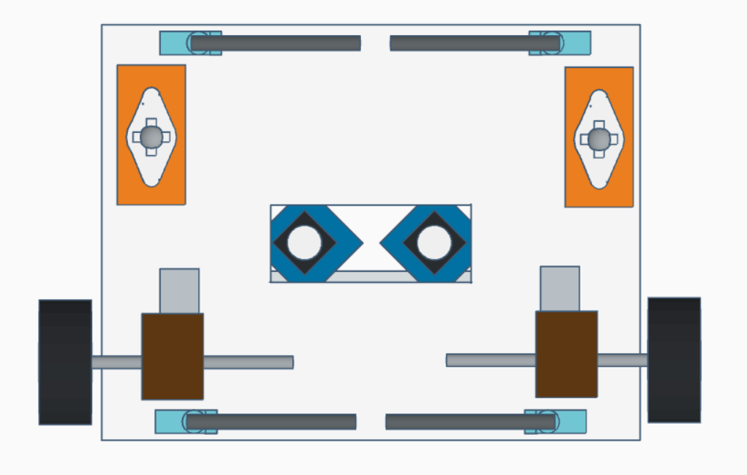
4 servo puck flicking mechanism
Each servo motor is responsible to each puck
Start accumulating points right after zones visiting with no additional robot movement
Fig. 17 Bottom view of the robot.
Crucial Aspects of Design
System Overview
Design Methodology
System Block Diagram
Motion Flow & Key Methods
Movement Mechanism
Puck Handling Mechanism
Colour Sensing Mechanism
Decision Making
Unused Alternative

Slide 21
4 servo puck flicking mechanism
→ Each servo motor is responsible to each puck
→ Start accumulating points right after zones visiting with no additional robot movement
Fig. 18 4 servo puck flicking mechanism.
Crucial Aspects of Design
System Overview
Design Methodology
System Block Diagram
Motion Flow & Key Methods
Movement Mechanism
Puck Handling Mechanism
Colour Sensing Mechanism
Decision Making
Unused Alternative

Slide 22
Crucial Aspects of Design
Shortest route movement strategy
Shortest movement time to visit all the zones
Move forwards and backwards only
No point turning
4 servo motor puck flicking mechanism
Each servo motor is responsible to each puck
Start accumulating points right after zones visiting with no additional robot movement
Crucial Aspects of Design
System Overview
Design Methodology
System Block Diagram
Motion Flow & Key Methods
Movement Mechanism
Puck Handling Mechanism
Colour Sensing Mechanism
Decision Making
Unused Alternative
Notes:
There is something interesting that the system block diagram cannot show, the crucial aspects of the design.
This competition requires a fast and reliable robot to shift as many pucks as possible in a limited period. Therefore, to ensure shortest movement time and shortest travelled distance to visit all the collection zones, the robot moves forwards straight into the collection zones at the beginning. The robot then only moves forwards and backwards in the 4 collection zones which saves movement time since it takes longer for movement if the robot needs to enter free zone. This movement strategy involves no point turning which lifts the burden of robot alignment. This is made possible by using 4 servo motor puck flicking mechanism. Each servo motor is attached to each corner of the chassis to be responsible for the puck in each collection zone. Besides, since the robot stays between the pucks after visiting all collection zones, this flicking mechanism allows immediate point accumulation with no extra movement.
These designs mainly are to reduce the movement time to leave more time for point accumulation.
~1.1m

Slide 23
02 Design Methodology
Motion Flow & Key Methods
Movement mechanism
Puck Handling mechanism
Colour Sensing mechanism
System Overview
Design Methodology
System Block Diagram
Crucial Aspects of Design
Motion Flow & Key Methods
Movement Mechanism
Puck Handling Mechanism
Colour Sensing Mechanism
Decision Making
Unused Alternative

Slide 24
5
6
7
8
Fig. 19 Motion flow.
Motion Flow & Key Methods
System Overview
Design Methodology
System Block Diagram
Crucial Aspects of Design
Movement Mechanism
Puck Handling Mechanism
Colour Sensing Mechanism
Decision Making
Unused Alternative

Slide 25
5
6
7
8
Fig. 19 Motion flow.
Motion Flow & Key Methods
System Overview
Design Methodology
System Block Diagram
Crucial Aspects of Design
Movement Mechanism
Puck Handling Mechanism
Colour Sensing Mechanism
Decision Making
Unused Alternative
Notes:
The robot then moves forwards straight into the puck collection zones 5 and 6 to have the pucks under the colour sensors. The forward movement and stopping at the right position make use of the movement mechanism.
~0.3m

Slide 26
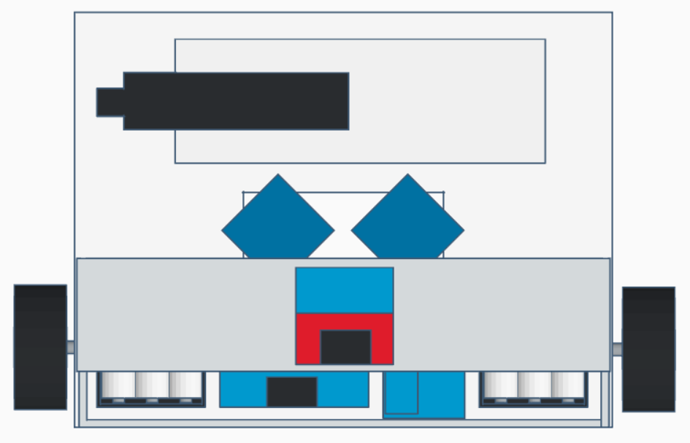
Movement Mechanism (Mechanical & Electronics)
Fig. 20 Bottom and top views of the robot.
Fig. 20 Bottom and top views of the robot.
DC motor with attached shaft encoder
Wheel
Light output phases
Travelled distance (Phase A & Phase B)
PSoC microcontroller
Castor ball
PSoC microcontroller
Puck Handling Subsystem
Fig. 9 L298N motor driver [6].
Gearbox
Fig. 10 Transfer plate [7].
Speed & direction (OUT1&OUT2 or OUT3&OUT4)
Wheel set
Spinning rod
Direction (IN1&IN2 or IN3&IN4), Speed (ENA or ENB)
Fig. 13 PSoC 5LP prototyping kit (CY8CKIT-059) [8].
Motor driver
Fig. 11 Wheel set.
Motor driver
DC motor with attached shaft encoder
Wheel
Puck Handling Subsystem
Gearbox
Movement Mechanism
Spinning rod
Fig. 11 Wheel set.
System Overview
Design Methodology
System Block Diagram
Crucial Aspects of Design
Puck Handling Mechanism
Colour Sensing Mechanism
Decision Making
Motion Flow & Key Methods
Unused Alternative
Notes:
As mentioned, each wheel in the wheel set has the same speed and direction as its DC motor. Each shaft encoder communicates with the PSoC microcontroller via a transfer plate while each DC motor does so via a motor driver. There is a pair of castor balls for third and fourth points of contact for stability and smooth movement of the robot.
~0.7m

Slide 27
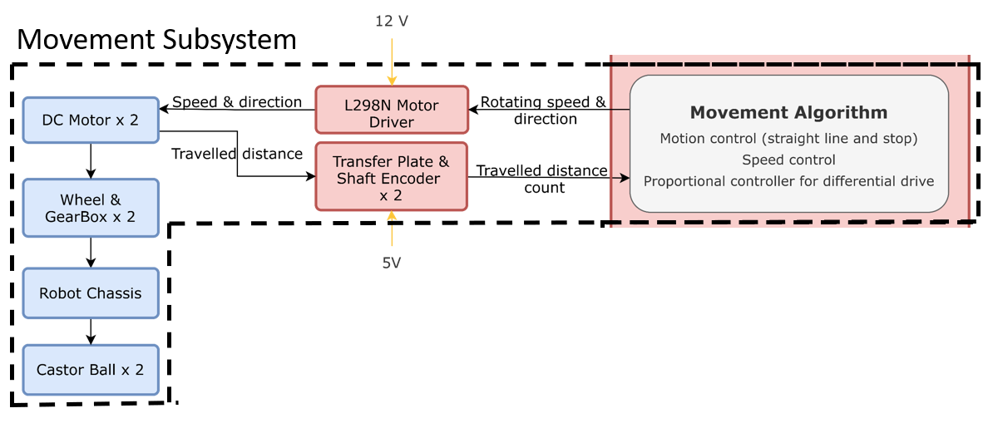
Movement Mechanism (Software)
Travelled distance feedback
Motion control
Straight-line motion
Stop movement
Speed control
Proportional controller for differential drive mechanism
Fig. 21 Movement Subsystem.
Movement Mechanism
System Overview
Design Methodology
System Block Diagram
Crucial Aspects of Design
Puck Handling Mechanism
Colour Sensing Mechanism
Decision Making
Motion Flow & Key Methods
Unused Alternative
Notes:
The movement algorithm can acknowledges travelled distance, conducts motion control, speed control and differential drive mechanism.
~0.2m

Slide 28
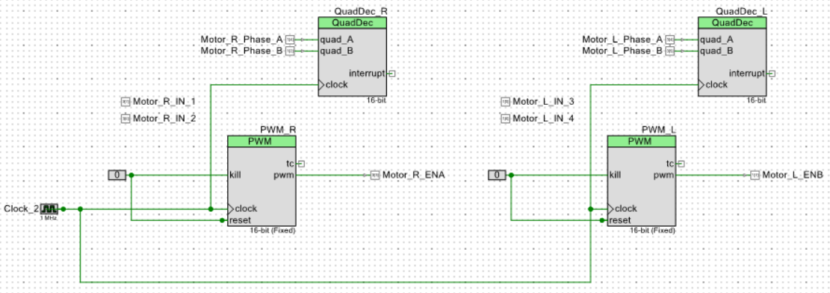
Travelled Distance Feedback
DC motor with attached shaft encoder
Wheel
Light output phases
Travelled distance (Phase A & Phase B)
Puck Handling Subsystem
Gearbox
Fig. 10 Transfer plate [7].
Spinning rod
Fig. 13 PSoC 5LP prototyping kit (CY8CKIT-059) [8].
Fig. 11 Wheel set.
Fig. 22 Top-level schematics of the movement subsystem.
Movement Mechanism
System Overview
Design Methodology
System Block Diagram
Crucial Aspects of Design
Puck Handling Mechanism
Colour Sensing Mechanism
Decision Making
Motion Flow & Key Methods
Unused Alternative
Notes:
The movement algorithm inputs 2 signals phase A and phase B from each shaft encoder to acknowledge the angular displacement of each wheel. These inputs are connected to a quadrature encoder component in the PSoC creator whose count can represent travelled distance of each wheel. Let’s see how the quadrature encoder works physically.
~0.4m

Slide 29
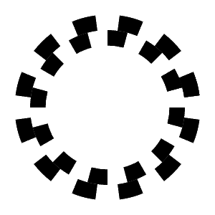
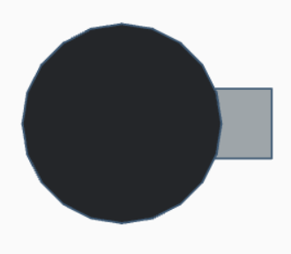
(Quadrature) Shaft Encoder
Transmitters
Light chopping disc
Receivers
“B” light
“A” light
State diagram for forward motion
Light Phase | “A” Output | “B” Output
1 | 0 | 0
2
3
4
Wheel
Fig. 23 Quadrature encoder and its wheel [11].
Movement Mechanism
System Overview
Design Methodology
System Block Diagram
Crucial Aspects of Design
Puck Handling Mechanism
Colour Sensing Mechanism
Decision Making
Motion Flow & Key Methods
Unused Alternative
Notes:
A shaft encoder has light transmitters, receivers and a light chopping disc as shown. The transmitters emit fixed light beam A and B to the disc and the corresponding receiver receives the light beam when the light is not blocked by a black spot of the disc. When a wheel keeps rotating, so does the encoder disc. This is reflected by changing light phases output. Thus, the movement algorithm can inputs the light phases output A and B constantly to compute the travelled distance of the wheel constantly for acknowledgement of robot position.
Optical Encoder (mit.edu)
~0.9m

Slide 30
(Quadrature) Shaft Encoder
Transmitters
Light chopping disc
Receivers
“B” light
“A” light
State diagram for forward motion
Phase | “A” Output | “B” Output
1 | 0 | 0
2 | 0 | 1
3
4
Wheel
Fig. 23 Quadrature encoder and its wheel [11].
Movement Mechanism
System Overview
Design Methodology
System Block Diagram
Crucial Aspects of Design
Puck Handling Mechanism
Colour Sensing Mechanism
Decision Making
Motion Flow & Key Methods
Unused Alternative

Slide 31
(Quadrature) Shaft Encoder
Transmitters
Light chopping disc
Receivers
“B” light
“A” light
State diagram for forward motion
Phase | “A” Output | “B” Output
1 | 0 | 0
2 | 0 | 1
3 | 1 | 1
4
Wheel
Fig. 23 Quadrature encoder and its wheel [11].
Movement Mechanism
System Overview
Design Methodology
System Block Diagram
Crucial Aspects of Design
Puck Handling Mechanism
Colour Sensing Mechanism
Decision Making
Motion Flow & Key Methods
Unused Alternative

Slide 32
(Quadrature) Shaft Encoder
Transmitters
Light chopping disc
Receivers
“B” light
“A” light
State diagram for forward motion
Phase | “A” Output | “B” Output
1 | 0 | 0
2 | 0 | 1
3 | 1 | 1
4 | 1 | 0
Wheel
Fig. 23 Quadrature encoder and its wheel [11].
Movement Mechanism
System Overview
Design Methodology
System Block Diagram
Crucial Aspects of Design
Puck Handling Mechanism
Colour Sensing Mechanism
Decision Making
Motion Flow & Key Methods
Unused Alternative

Slide 33
Motion Control
DC motor with attached shaft encoder
Wheel
Puck Handling Subsystem
Fig. 9 L298N motor driver [6].
Gearbox
Speed & direction (OUT1&OUT2 or OUT3&OUT4)
Spinning rod
Direction (IN1&IN2 or IN3&IN4), Speed (ENA or ENB)
Fig. 13 PSoC 5LP prototyping kit (CY8CKIT-059) [8].
Fig. 11 Wheel set.
Movement Mechanism
System Overview
Design Methodology
System Block Diagram
Crucial Aspects of Design
Puck Handling Mechanism
Colour Sensing Mechanism
Decision Making
Motion Flow & Key Methods
Unused Alternative
Notes:
Besides, the algorithm also controls 3 motions, stopping, rotating clockwise and anticlockwise of each wheel by adjusting the pair of binary bits IN1 IN2 or IN3 IN4. The 2 wheels rotate in the same direction for the robot to move forward and backward.

Slide 34
Speed Control
DC motor with attached shaft encoder
Wheel
Puck Handling Subsystem
Fig. 9 L298N motor driver [6].
Gearbox
Speed & direction (OUT1&OUT2 or OUT3&OUT4)
Spinning rod
Direction (IN1&IN2 or IN3&IN4), Speed (ENA or ENB)
Fig. 13 PSoC 5LP prototyping kit (CY8CKIT-059) [8].
Fig. 11 Wheel set.
Fig. 22 Top-level schematics of the movement subsystem.
Movement Mechanism
System Overview
Design Methodology
System Block Diagram
Crucial Aspects of Design
Puck Handling Mechanism
Colour Sensing Mechanism
Decision Making
Motion Flow & Key Methods
Unused Alternative
Notes:
Thirdly, the algorithm can vary the output pwm duty cycle to the enable pin to change speed of a wheel. Each wheel has 1 respective enable pin on the motor driver.

Slide 35

Movement Subsystem (Software)
Travelled distance feedback
Motion control
Straight-line motion
Stop movement
Speed control
Proportional controller for differential drive mechanism
Fig. 21 Movement Subsystem.
Movement Mechanism
System Overview
Design Methodology
System Block Diagram
Crucial Aspects of Design
Puck Handling Mechanism
Colour Sensing Mechanism
Decision Making
Motion Flow & Key Methods
Unused Alternative
Notes:
These 3 basic functions, acknowledgement of travelled distance, speed control, and motion control enable differential drive mechanism.

Slide 36
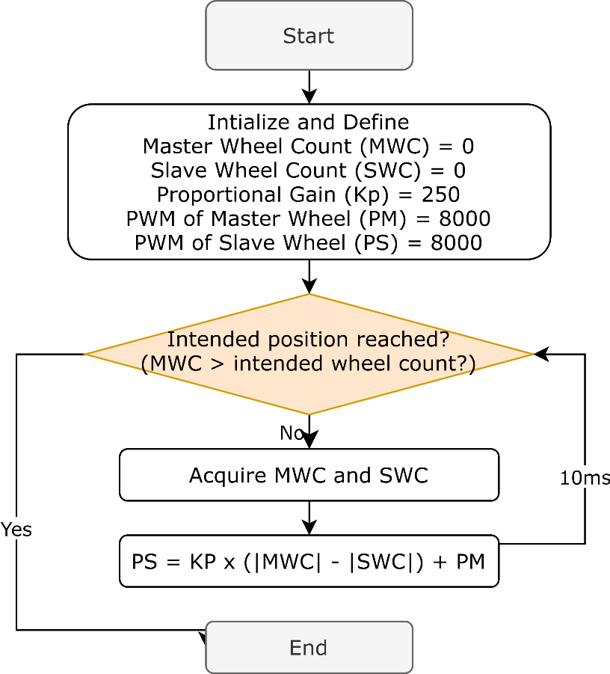
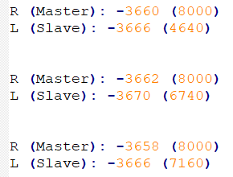
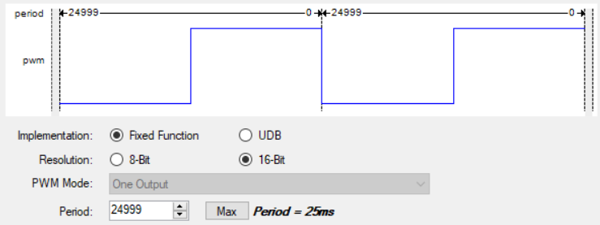
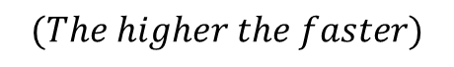
Proportional Controller for Differential Drive
Kp = 250 (Stop at -3770)
Count error margin < 10
Fig. 25 Parameters of Pulse Width Modulator (PWM) for the motors.
$$PWM_{slave}:=K_{p}×\left(\left|Count_{master}\right|−\left|Count_{slave}\right|\right)+PWM_{master} [12]$$
$$If \left|Count_{master}\right|>\left|Count_{slave}\right|, then make PWM_{slave}>PWM_{master}$$
$$If \left|Count_{master}\right|<\left|Count_{slave}\right|, then make PWM_{slave}<PWM_{master}$$
Fig. 24 Flow diagram of the differential drive mechanism.
Movement Mechanism
$$PWM_{master}=\frac{8000μs}{25000μs}×100\%=32\% duty cycle$$
$$(The higher the faster)$$
System Overview
Design Methodology
Decision Making
System Block Diagram
Crucial Aspects of Design
Motion Flow & Key Methods
Colour Sensing Mechanism
Puck Handling Colour Sensing Mechanism
Unused Alternative
Notes:
The 2 wheels tend to have different physical speed despite same coded speed due to physical limitations. Therefore, the algorithm uses proportional controller for the differential drive mechanism to align speed of both wheels for smooth robot movement.
Before starting, we chose the right wheel to be the master wheel and the left to be the slave wheel. Speed of master wheel never changes while the speed of slave wheel is tuned constantly.
At first, we initialize shaft encoder count of both wheels to be 0.
Next is to define the proportional gain to be 250 which is obtained by trials and errors as too large the value oscillates the control output while too small the value induces slow response.
We then set both PWM compare values which reflects speeds to be 8000 initially which represents 32% duty cycle for a period of 25ms.
After then, the algorithm checks if the intended position is reached. If the condition is not met, the algorithm acquires the wheel counts and adjusts the speed of the slave wheel by changing the corresponding PWM compare value according to the equation shown. If the master wheel moves faster than the slave wheel at an instant, its wheel count must be larger and thus increases the speed of the slave wheel right after this instant to compensate the difference in travelled distance between the wheels. If the opposite happens, the speed of the slave wheel would be decreased. After 10 milliseconds, the process repeats until the intended wheel count is reached where the robot would stop movement.
The key movement methods are done and let’s get back to the robot motion flow.

Slide 37
5
6
7
8
Fig. 19 Motion flow.
Motion Flow & Key Methods
System Overview
Design Methodology
System Block Diagram
Crucial Aspects of Design
Movement Mechanism
Puck Handling Mechanism
Colour Sensing Mechanism
Decision Making
Unused Alternative
Notes:
The robot then moves forwards straight into the puck collection zones 5 and 6 to have the pucks under the colour sensors. The forward movement and stopping at the right position make use of the movement mechanism.
~0.3m

Slide 38
Colour Sensing Mechanism (Electronics)
Fig. 20 Bottom and top views of the robot.
2 TCS3200 colour sensors for simultaneous colour sensing
64 photodiodes each with a filter
Filter | Number of photodiodes
Red | 16
Blue | 16
Green | 16
Clear (None) | 16
Fig. 2 TCS3200 colour sensor [1].
Colour Sensing Mechanism
System Overview
Design Methodology
System Block Diagram
Crucial Aspects of Design
Puck Handling Mechanism
Decision Making
Motion Flow & Key Methods
Movement Mechanism
Unused Alternative
Notes:
Jual GY-31 TCS3200 Color Sensor Module (jogjarobotika.com)
TCS3200 Colour Sensor Module - Elecrow
The colour sensor has a 8x8 array of photodiodes with different type of filters. 16 of them have red filters, the same number goes to blue, green and clear filters.
~1m

Slide 39
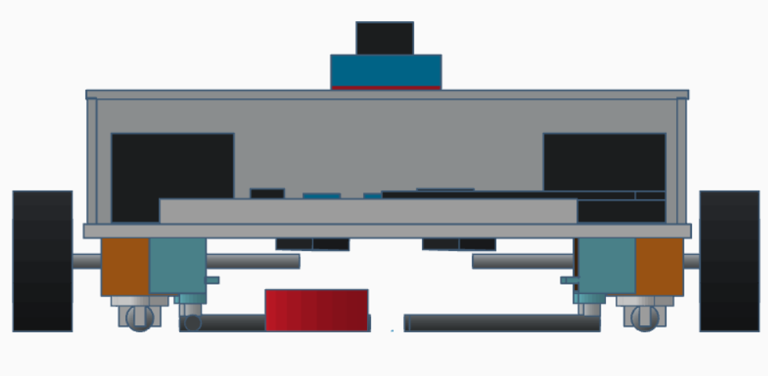
Red Puck Example
Fig. 26 Front view of the robot with a red puck under one of the colour sensors.
*The same logic is also valid for blue and green pucks!
Colour Sensing Mechanism
System Overview
Design Methodology
System Block Diagram
Crucial Aspects of Design
Puck Handling Mechanism
Decision Making
Motion Flow & Key Methods
Movement Mechanism
Unused Alternative
Notes:
Jual GY-31 TCS3200 Color Sensor Module (jogjarobotika.com)
TCS3200 Colour Sensor Module - Elecrow
The colour sensor has a 8x8 array of photodiodes with different type of filters. 16 of them have red filters, the same number goes to blue, green and clear filters. Let’s assume a red puck is under the colour sensor. When the LEDs illuminate the red puck, the red puck tends to reflect higher irradiance of red component of light to the photodiodes with red filter which only receives red component of reflected light. This causes the current passing through the red photodiode to be higher compared to other photodiodes. The larger current is converted proportionally to a digital square wave at the output to the microcontroller with a larger frequency. The same logic is also valid for blue and green pucks. We can now move on to the algorithm.
~1m

Slide 40
Red Puck Example
Fig. 3 TCS3200 colour sensor block diagram [2].
Colour Sensing Mechanism
System Overview
Design Methodology
System Block Diagram
Crucial Aspects of Design
Puck Handling Mechanism
Decision Making
Motion Flow & Key Methods
Movement Mechanism
Unused Alternative
Notes:
Jual GY-31 TCS3200 Color Sensor Module (jogjarobotika.com)
TCS3200 Colour Sensor Module - Elecrow
The colour sensor has a 8x8 array of photodiodes with different type of filters. 16 of them have red filters, the same number goes to blue, green and clear filters. Let’s assume a red puck is under the colour sensor. When the LEDs illuminate the red puck, the red puck tends to reflect higher irradiance of red component of light to the photodiodes with red filter which only receives red component of reflected light. This causes the current passing through the red photodiode to be higher compared to other photodiodes. The larger current is converted proportionally to a digital square wave at the output to the microcontroller with a larger frequency. The same logic is also valid for blue and green pucks. We can now move on to the algorithm.
~1m

Slide 41
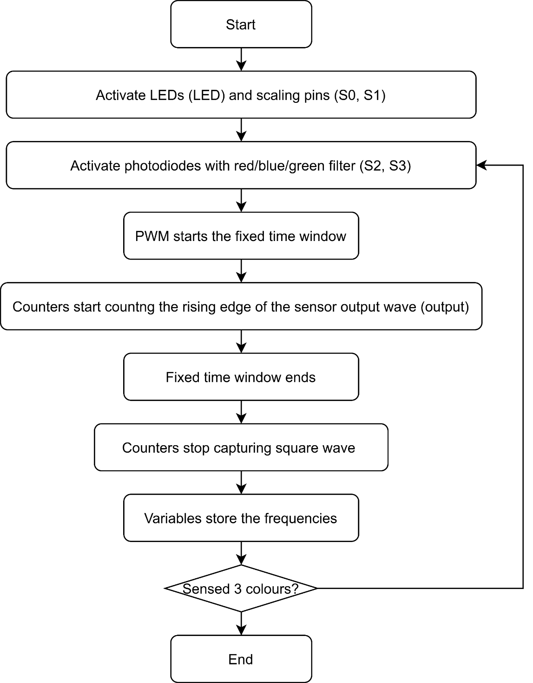
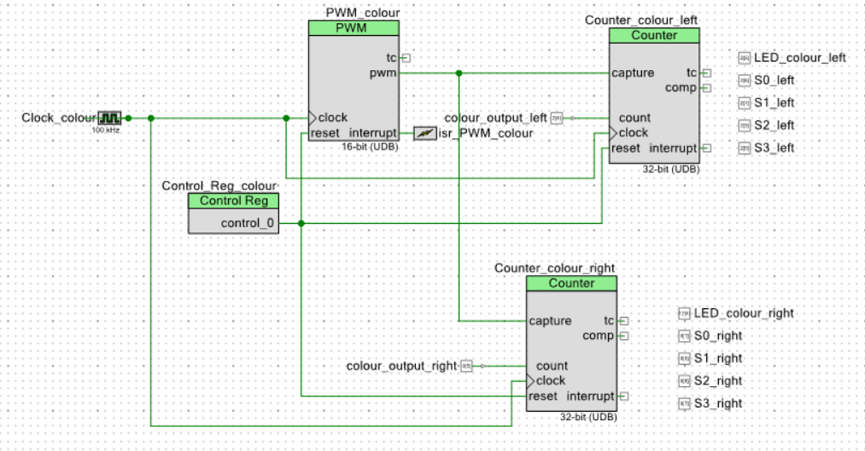
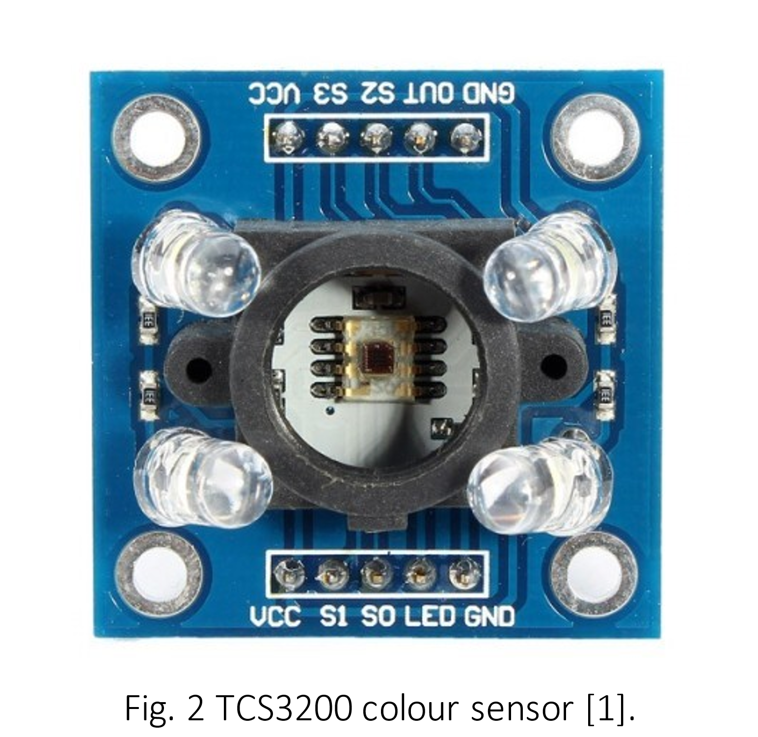
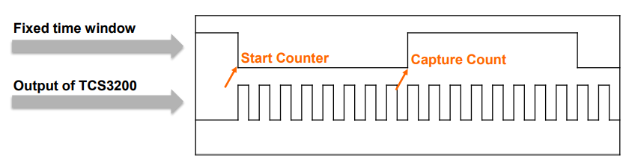
Colour Sensing Mechanism (Software)
Fig. 27 Flow diagram of the colour sensing mechanism.
LEDs on and off
(LED)
Output frequency scaling (S0 & S1)
Photodiode type
(S2 & S3)
Fig. 28 Top-level schematics of the colour sensing subsystem.
Output frequency
(OUT)
Fig. 13 PSoC 5LP prototyping kit (CY8CKIT-059) [8].
(PWM repeats)
Colour Sensing Mechanism
Fig. 29 Counter captures number of output waves.
System Overview
Design Methodology
System Block Diagram
Crucial Aspects of Design
Puck Handling Mechanism
Decision Making
Motion Flow & Key Methods
Movement Mechanism
Unused Alternative
Notes:
The algorithm starts by activating the LEDs and the scaling pins for large enough output frequency and easier computation. After then, the photodiodes with red filter are activated.
//The PWM starts the fixed time window where the counters starts to count the rising edge of the sensor output wave. Two counters are used in the software for simultaneous colour sensing.
Once the fixed time window ends, the counters stop capturing the output wave and the output wave frequency is stored in the algorithm. The same process repeats for blue and green photodiodes. This flow shown here is then repeated 3 times and an average is taken for higher accuracy. The highest average frequency would determine the puck colour.
The colour sensing method is now clear and let’s get back to the motion flow of the robot.
~1m20s

Slide 42
5
6
7
8
Fig. 19 Motion flow.
Puck Handling Mechanism
System Overview
Design Methodology
Decision Making
System Block Diagram
Crucial Aspects of Design
Motion Flow & Key Methods
Movement Mechanism
Colour Sensing Mechanism
Unused Alternative
Notes:
Colour sensing is then done. The puck at zone 6 is valid and the robot will then attempt to flick it.

Slide 43
5
6
7
8
Fig. 19 Motion flow.
Puck Handling Mechanism
System Overview
Design Methodology
Decision Making
System Block Diagram
Crucial Aspects of Design
Motion Flow & Key Methods
Movement Mechanism
Colour Sensing Mechanism
Unused Alternative
Notes:
The motor first moves forwards for a certain distance.

Slide 44
5
6
7
8
Fig. 19 Motion flow.
Puck Handling Mechanism
System Overview
Design Methodology
Decision Making
System Block Diagram
Crucial Aspects of Design
Motion Flow & Key Methods
Movement Mechanism
Colour Sensing Mechanism
Unused Alternative
Notes:
To close the back servo rods.

Slide 45
5
6
7
8
Fig. 19 Motion flow.
Puck Handling Mechanism
System Overview
Design Methodology
Decision Making
System Block Diagram
Crucial Aspects of Design
Motion Flow & Key Methods
Movement Mechanism
Colour Sensing Mechanism
Unused Alternative
Notes:
It then moves backwards to the center between the pucks,

Slide 46
5
6
7
8
Fig. 19 Motion flow.
Puck Handling Mechanism
System Overview
Design Methodology
Decision Making
System Block Diagram
Crucial Aspects of Design
Motion Flow & Key Methods
Movement Mechanism
Colour Sensing Mechanism
Unused Alternative
Notes:
And flicks the valid puck. This puck shifting activity is made possible by the puck handling subsystem.

Slide 47
4 servo puck flicking mechanism
Each servo motor is responsible to each puck
Start accumulating points right after zones visiting with no additional robot movement
Fig. 17 Bottom view of the robot.
Puck Handling Mechanism
System Overview
Design Methodology
Decision Making
System Block Diagram
Crucial Aspects of Design
Motion Flow & Key Methods
Movement Mechanism
Colour Sensing Mechanism
Unused Alternative

Slide 48
Fig. 18 4 servo puck flicking mechanism.
4 servo puck flicking mechanism
→ Each servo motor is responsible to each puck
→ Start accumulating points right after zones visiting with no additional robot movement
Puck Handling Mechanism
System Overview
Design Methodology
Decision Making
System Block Diagram
Crucial Aspects of Design
Motion Flow & Key Methods
Movement Mechanism
Colour Sensing Mechanism
Unused Alternative

Slide 49
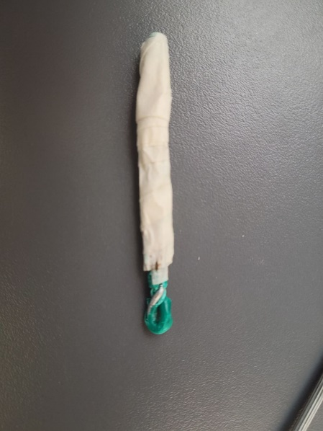
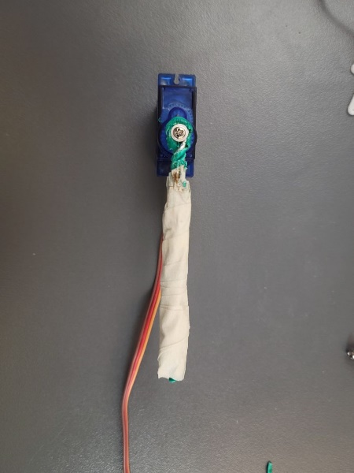

Puck Handling Mechanism (hardware & electronics)
Fig. 30 Servo rods.
Fig. 6 180-degree SG90 plastic gear servo motor [4].
Fig. 7 Servo motor with a rod attached.
(for angular displacement of servo rod)
Fig. 4 Input and output pins of SG90 plastic gear servo motor [3].
Puck Handling Mechanism
System Overview
Design Methodology
Decision Making
System Block Diagram
Crucial Aspects of Design
Motion Flow & Key Methods
Movement Mechanism
Colour Sensing Mechanism
Unused Alternative
Notes:
Each servo is connected to a rod via xxx. The rod is made of yyy. The servo has an input pin connected to the microcontroller for the puck handling algorithm to instruct rotation of shaft and thus the rod.

Slide 50
Puck Handling Mechanism (Software)
5
6
5
Flicking track
Dragging track
6
~5.5cm
~xx deg
7
8
7
8
Fig. 31 If the servo rod drags the valid puck.
Fig. 32 If the servo rod flicks the valid puck.
Puck Handling Mechanism
System Overview
Design Methodology
Decision Making
System Block Diagram
Crucial Aspects of Design
Motion Flow & Key Methods
Movement Mechanism
Colour Sensing Mechanism
Unused Alternative
Notes:
For each servo rod, the distance between the pivot and the point of contact of the puck is roughly 5.5cm. Since the distance is not large enough for dragging action, flicking is used. The angular displacement of the servo rod to flick puck into the capture zone is roughly xx deg which is obtained by trials and errors.

Slide 51
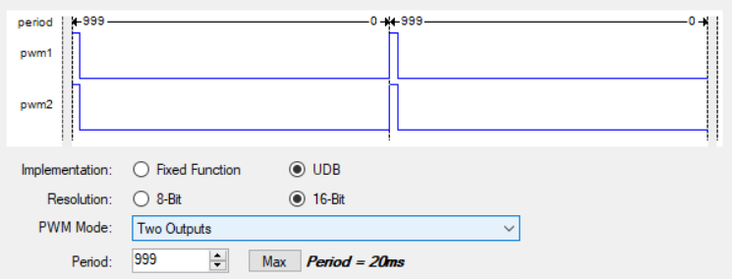
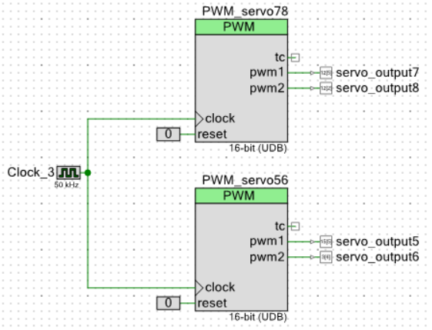
Puck Handling Mechanism (Software)
2-output PWM
(50kHz)
Fig. 34 PWM_servo78 and PWM_servo56 signals.
Fig. 33 Top-level schematics of the puck handling subsystem.
Fig. 4 Input and output pins of SG90 plastic gear servo motor [3].
Puck Handling Mechanism
System Overview
Design Methodology
Decision Making
System Block Diagram
Crucial Aspects of Design
Motion Flow & Key Methods
Movement Mechanism
Colour Sensing Mechanism
Unused Alternative
Notes:
How Servo Motors Work | Servo Motors High Efficiency and Power (jameco.com)
The puck handling algorithm makes use of 2 2-output PWM to control the angular position of the servo rods by changing corresponding PWM compare value. PWM compare value represents the PWM pulse width or the duty cycle. Increasing the duty cycle rotates the rod to one direction while decreasing rotates the rod to the other direction. As a PWM period of 50kHz is used, change of pulse width by 1ms rotates the servo rod by 180 degrees. For less than 180 degree rotation, the pulse width change is scaled accordingly. The puck handling algorithm thus rotates the servo rod whenever needed according to the motion flow.
~1m45s

Slide 52
5
6
7
8
Rod flicked, Rod stays
Fig. 19 Motion flow.
Puck Handling Mechanism
System Overview
Design Methodology
Decision Making
System Block Diagram
Crucial Aspects of Design
Motion Flow & Key Methods
Movement Mechanism
Colour Sensing Mechanism
Unused Alternative
Notes:
Once the 2 second period is over, the servo rod retracts.

Slide 53
5
6
7
8
Rod retracts, Robot waits
Fig. 19 Motion flow.
Puck Handling Mechanism
System Overview
Design Methodology
Decision Making
System Block Diagram
Crucial Aspects of Design
Motion Flow & Key Methods
Movement Mechanism
Colour Sensing Mechanism
Unused Alternative
Notes:
The system integrator can then placed back the captured puck into the black circle. Since no puck detection sensor is used, the robot depends solely on a delay of 8s to ensure the system integrator is able to placed the puck back before robot continues its activities.

Slide 54
5
6
7
8
Finished a puck capture by “flick, stay, retract and wait”
Fig. 19 Motion flow.
Puck Handling Mechanism
System Overview
Design Methodology
Decision Making
System Block Diagram
Crucial Aspects of Design
Motion Flow & Key Methods
Movement Mechanism
Colour Sensing Mechanism
Unused Alternative

Slide 55
5
6
7
8
Fig. 19 Motion flow.
Puck Handling Mechanism
System Overview
Design Methodology
Decision Making
System Block Diagram
Crucial Aspects of Design
Motion Flow & Key Methods
Movement Mechanism
Colour Sensing Mechanism
Unused Alternative
Notes:
The robot then moves forwards to zones 7 and 8 for colour detection of the pucks.

Slide 56
5
6
7
8
Fig. 19 Motion flow.
Puck Handling Mechanism
System Overview
Design Methodology
Decision Making
System Block Diagram
Crucial Aspects of Design
Motion Flow & Key Methods
Movement Mechanism
Colour Sensing Mechanism
Unused Alternative
Notes:
After colour detection, the robot moves backwards to the center between the pucks.

Slide 57
5
6
7
8
Fig. 19 Motion flow.
Puck Handling Mechanism
System Overview
Design Methodology
Decision Making
System Block Diagram
Crucial Aspects of Design
Motion Flow & Key Methods
Movement Mechanism
Colour Sensing Mechanism
Unused Alternative
Notes:
The robot then flicks the valid puck at zone 7. Again, the servo rod retracts after 2 seconds.

Slide 58
5
6
7
8
Fig. 19 Motion flow.
Puck Handling Mechanism
System Overview
Design Methodology
Decision Making
System Block Diagram
Crucial Aspects of Design
Motion Flow & Key Methods
Movement Mechanism
Colour Sensing Mechanism
Unused Alternative
Notes:
The robot then flicks the valid puck at zone 7. Again, the servo rod retracts after 2 seconds.

Slide 59
5
6
7
8
Fig. 19 Motion flow.
Puck Handling Mechanism
System Overview
Design Methodology
Decision Making
System Block Diagram
Crucial Aspects of Design
Motion Flow & Key Methods
Movement Mechanism
Colour Sensing Mechanism
Unused Alternative
Notes:
The system integrator then has 8 seconds to place back the valid puck.

Slide 60
5
6
7
8
Fig. 19 Motion flow.
Puck Handling Mechanism
System Overview
Design Methodology
Decision Making
System Block Diagram
Crucial Aspects of Design
Motion Flow & Key Methods
Movement Mechanism
Colour Sensing Mechanism
Unused Alternative
Notes:
The system integrator then has 8 seconds to place back the valid puck. The robot has managed to visit all the zones and it stays stationary from now on to accumulate points.

Slide 61
5
6
7
8
Fig. 19 Motion flow.
Puck Handling Mechanism
System Overview
Design Methodology
Decision Making
System Block Diagram
Crucial Aspects of Design
Motion Flow & Key Methods
Movement Mechanism
Colour Sensing Mechanism
Unused Alternative
Notes:
The cycle of flicking and puck replacement focusing on a valid puck repeats until the end of the half round.

Slide 62
5
6
7
8
Fig. 19 Motion flow.
Puck Handling Mechanism
System Overview
Design Methodology
Decision Making
System Block Diagram
Crucial Aspects of Design
Motion Flow & Key Methods
Movement Mechanism
Colour Sensing Mechanism
Unused Alternative

Slide 63
5
6
7
8
Fig. 19 Motion flow.
Puck Handling Mechanism
System Overview
Design Methodology
Decision Making
System Block Diagram
Crucial Aspects of Design
Motion Flow & Key Methods
Movement Mechanism
Colour Sensing Mechanism
Unused Alternative

Slide 64
03 Decision Making
Unused Alternative Design
System Overview
Design Methodology
System Block Diagram
Crucial Aspects of Design
Motion Flow & Key Methods
Movement Mechanism
Puck Handling Mechanism
Colour Sensing Mechanism
Decision Making
Unused Alternative

Slide 65
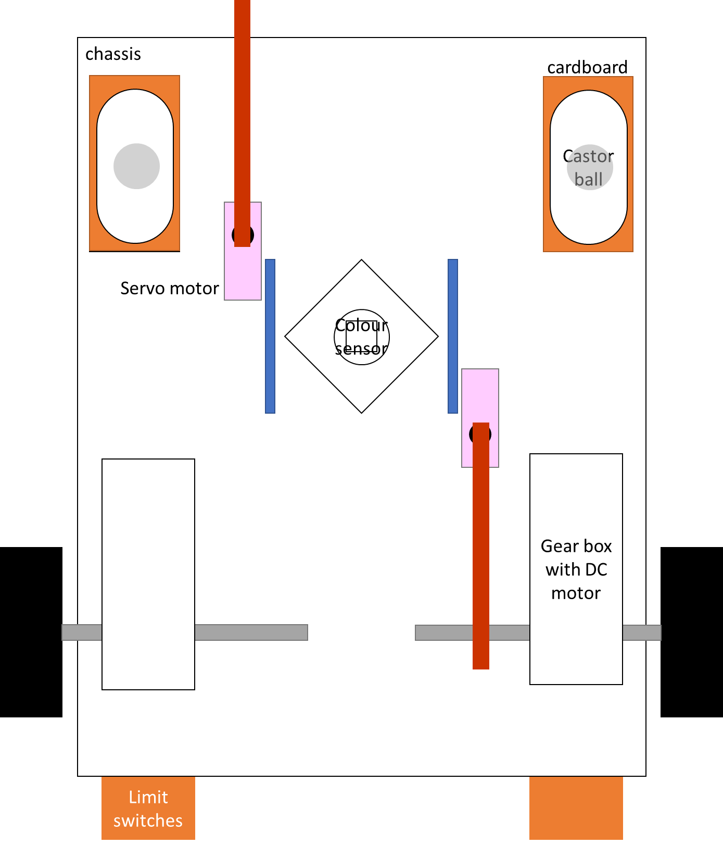
Unused Alternative Design
Visit collection zones one by one
Longer route & time needed
Point turning
Alignment / reorientation needed
Possible extra movement
Longer route & time needed
Fig. 35 Unused alternative design.
Unused Alternative
System Overview
Design Methodology
System Block Diagram
Crucial Aspects of Design
Motion Flow & Key Methods
Movement Mechanism
Puck Handling Mechanism
Colour Sensing Mechanism
Decision Making

Slide 66
Unused Alternative Design
Visit collection zones one by one
Longer route & time needed
Approximate Travel Distance (Count) To Visit All Collection Zones Excluding Point Turning | Shaft Encoder Count Before Puck Accumulation Assuming A Valid Puck at Zone 7
Movement to Any Collection Zone | Alternative Design | Current Design
Starting Base to One Zone | 2200 | 2200
To Next Zone | 2000 | -
To Next Zone | 5000 | 2000
To Next Zone | 2000 | -
Total | 11200 | 4200
Fig. 35 Unused alternative design.
Unused Alternative
System Overview
Design Methodology
System Block Diagram
Crucial Aspects of Design
Motion Flow & Key Methods
Movement Mechanism
Puck Handling Mechanism
Colour Sensing Mechanism
Decision Making
Notes:
Next is about our alternative design. We have been trying to improve our design of the robot and the motion flow that we have thought of many different design. One major alternative is a rather conventional robot as shown.
Only 2 servo motors and 1 colour sensor are used. This signifies that the robot has to go through all collection zones one by one to visit them.
In addition, the movement involves point turning which increases the risk of robot misalignment and requires reorientation mechanism by pushing limit switches against the wall after every point turning. The reorientation process demands time in the competition as well as from us to learn to apply the switches by ourselves.
Moreover, since there is no simultaneous colour sensing mechanism, the robot also needs more time for colour sensing.
Fourthly, the robot cannot stay stationary for point accumulation which introduces more uncertainty and more power needed.
Lastly, if it turns out that zones5 and 7 have no valid puck, the robot needs to move an even longer route to start accumulating points.
In other words, the alternative design is no much simpler although it involves less servo motors and colour sensors, it uses limit switches which we never used before. In addition, the alternative design takes a longer time to visit all the zones before starting accumulating points compared to our current design. As a result, the alternative design is not used.

Slide 67
5
6
5
6
7
8
7
8
Fig. 36 Motion flow of alternative design.
Fig. 19 Motion flow of our current design.
Approximate Travel Distance (Count) To Visit All Collection Zones Excluding Point Turning | Shaft Encoder Count Before Puck Accumulation Assuming A Valid Puck at Zone 7
Movement to Any Collection Zone | Alternative Design | Current Design
Starting Base to One Zone | 2200 | 2200
To Next Zone | 2000 | -
To Next Zone | 5000 | 2000
To Next Zone | 2000 | -
Total | 11200 | 4200
Visit collection zones one by one
→ Longer route & time needed
Unused Alternative
System Overview
Design Methodology
System Block Diagram
Crucial Aspects of Design
Motion Flow & Key Methods
Movement Mechanism
Puck Handling Mechanism
Colour Sensing Mechanism
Decision Making

Slide 68
Point turning
→ Alignment / reorientation needed
5
6
7
8
Fig. 36 Motion flow of alternative design.
Unused Alternative
System Overview
Design Methodology
System Block Diagram
Crucial Aspects of Design
Motion Flow & Key Methods
Movement Mechanism
Puck Handling Mechanism
Colour Sensing Mechanism
Decision Making

Slide 69
Point turning
→ Alignment / reorientation needed
5
6
7
8
Fig. 36 Motion flow of alternative design.
Unused Alternative
System Overview
Design Methodology
System Block Diagram
Crucial Aspects of Design
Motion Flow & Key Methods
Movement Mechanism
Puck Handling Mechanism
Colour Sensing Mechanism
Decision Making

Slide 70
Point turning
→ Alignment / reorientation needed
5
6
7
8
Fig. 36 Motion flow of alternative design.
Unused Alternative
System Overview
Design Methodology
System Block Diagram
Crucial Aspects of Design
Motion Flow & Key Methods
Movement Mechanism
Puck Handling Mechanism
Colour Sensing Mechanism
Decision Making

Slide 71
Point turning
→ Alignment / reorientation needed
5
6
7
8
Fig. 36 Motion flow of alternative design.
Unused Alternative
System Overview
Design Methodology
System Block Diagram
Crucial Aspects of Design
Motion Flow & Key Methods
Movement Mechanism
Puck Handling Mechanism
Colour Sensing Mechanism
Decision Making

Slide 72
Point turning
→ Alignment / reorientation needed
5
6
7
8
Fig. 36 Motion flow of alternative design.
Unused Alternative
System Overview
Design Methodology
System Block Diagram
Crucial Aspects of Design
Motion Flow & Key Methods
Movement Mechanism
Puck Handling Mechanism
Colour Sensing Mechanism
Decision Making

Slide 73
Unused Alternative Design
Visit collection zones one by one
Longer route & time needed
Point turning
Alignment / reorientation needed
Possible extra movement
Longer route & time needed
Fig. 35 Unused alternative design.
Unused Alternative
System Overview
Design Methodology
System Block Diagram
Crucial Aspects of Design
Motion Flow & Key Methods
Movement Mechanism
Puck Handling Mechanism
Colour Sensing Mechanism
Decision Making
Notes:
Next is about our alternative design. We have been trying to improve our design of the robot and the motion flow that we have thought of many different design. One major alternative is a rather conventional robot as shown.
Only 2 servo motors and 1 colour sensor are used. This signifies that the robot has to go through all collection zones one by one to visit them.
In addition, the movement involves point turning which increases the risk of robot misalignment and requires reorientation mechanism by pushing limit switches against the wall after every point turning. The reorientation process demands time in the competition as well as from us to learn to apply the switches by ourselves.
Moreover, since there is no simultaneous colour sensing mechanism, the robot also needs more time for colour sensing.
Fourthly, the robot cannot stay stationary for point accumulation which introduces more uncertainty and more power needed.
Lastly, if it turns out that zones5 and 7 have no valid puck, the robot needs to move an even longer route to start accumulating points.
In other words, the alternative design is no much simpler although it involves less servo motors and colour sensors, it uses limit switches which we never used before. In addition, the alternative design takes a longer time to visit all the zones before starting accumulating points compared to our current design. As a result, the alternative design is not used.

Slide 74

I’m fat but I can start accumulating points immediately~
5
6
5
6
>﹏<
￣▽￣
7
8
7
8
Possible extra movement
→ Longer route & time needed
Fig. 36 Motion flow of alternative design.
Fig. 19 Motion flow of current design.
Unused Alternative
System Overview
Design Methodology
System Block Diagram
Crucial Aspects of Design
Motion Flow & Key Methods
Movement Mechanism
Puck Handling Mechanism
Colour Sensing Mechanism
Decision Making

Slide 75
Unused Alternative Design
>﹏<
Visit collection zones one by one
Longer route & time needed
Point turning
Alignment / reorientation needed
Possible extra movement
Longer route & time needed
Fig. 35 Unused alternative design.
Unused Alternative
System Overview
Design Methodology
System Block Diagram
Crucial Aspects of Design
Motion Flow & Key Methods
Movement Mechanism
Puck Handling Mechanism
Colour Sensing Mechanism
Decision Making
Notes:
Next is about our alternative design. We have been trying to improve our design of the robot and the motion flow that we have thought of many different design. One major alternative is a rather conventional robot as shown.
Only 2 servo motors and 1 colour sensor are used. This signifies that the robot has to go through all collection zones one by one to visit them.
In addition, the movement involves point turning which increases the risk of robot misalignment and requires reorientation mechanism by pushing limit switches against the wall after every point turning. The reorientation process demands time in the competition as well as from us to learn to apply the switches by ourselves.
Moreover, since there is no simultaneous colour sensing mechanism, the robot also needs more time for colour sensing.
Fourthly, the robot cannot stay stationary for point accumulation which introduces more uncertainty and more power needed.
Lastly, if it turns out that zones5 and 7 have no valid puck, the robot needs to move an even longer route to start accumulating points.
In other words, the alternative design is no much simpler although it involves less servo motors and colour sensors, it uses limit switches which we never used before. In addition, the alternative design takes a longer time to visit all the zones before starting accumulating points compared to our current design. As a result, the alternative design is not used.

Slide 76



Summary
Simple Yet Efficient
X long routes
X realignment
Stationary
=

Slide 77
Thank you!

Slide 78
Reference
[1] “GY-31 TCS3200 COLOR SENSOR MODULE.” JOGJAROBOTIKA. http://www.jogjarobotika.com/sensor- warna/1317-gy-31-tcs3200-color-sensor-module.html (accessed Oct. 13, 2021).
[2] ams AG, “TCS3200, TCS3210 Programmable Color Light-to-Frequency Converter,” TCS3200 datasheet, 2016.
[3] “SG90 Servo Motor Datasheet,” SG90 datasheet, 2021.
[4] “TOWER PRO SG90 9G – Miniature Servo Motor.” ELECTRONICA EMBAJADORES. https://www.electronicaembajadores.com/en/Productos/Detalle/MMSV002/motors-servo-motors-linear- actuators/servo-motors/tower-pro-sg90-9g-miniature-servo-motor (accessed Oct. 13, 2021).
[5] “Johnson Standard 130 Motor Green Miniature DC Motor with Encoder Mini motro 25g Shaft Dia 2mm.” Amazon. https://www.amazon.in/Johnson-Standard-130-Miniature-encoder/dp/B07372CWTZ (accessed Oct. 13, 2021).
[6] “2Amp 7V-30V L298N Motor Driver / Stepper Driver (2 Channels).” Cytron. https://my.cytron.io/p-2amp-7v-30v- l298n-motor-driver-stepper-driver-2-channels?r=1 (accessed Oct. 13, 2021).
[7] A. A. Mohanan, “Motor connections,” L298N datasheet, 2021.

Slide 79
Reference
[8] “CY8CKIT-059.” Mouser Malaysia. https://my.mouser.com/ProductDetail/Cypress-Semiconductor/CY8CKIT- 059?qs=PhR8RmCirEblciDRmpiVDw%3D%3D (accessed Oct. 13, 2021).
[9] “Beston 4pcs AA 3000mAh Ni-MH Rechargeable Batteries.” Shopee. https://shopee.com.my/Beston-4pcs- AA-3000mAh-Ni-MH-Rechargeable-Batteries-i.139879612.2111664617?position=6 (accessed Oct. 13, 2021).
[10] “LM2596 3A Buck Module with Display.” Cytron. https://my.cytron.io/p-lm2596-3a-buck-module-with- display?r=1&gclid=CjwKCAjwx8iIBhBwEiwA2quaq3v3F6hXLGpGe9ybfT0OdBRwqcSm55jbO2NBUbKHs_kZ3i 3WsphPFBoCaL8QAvD_BwE (accessed Oct. 13, 2021).
[11] “Optical Encoder Project.” MIT.edu. https://groups.csail.mit.edu/mac/users/pmitros/encoder/ (accessed Oct. 13, 2021).
[12] A. A. Mohanan. ECE3091. Class Lecture, Topic: “Control.” School of Engineering, Monash University Malaysia, 2021.

